Slide 1



Habitat for Humanity of Greater Los Angeles Valley Village Neighborhood Council Presentation.
Notes:
ER

Slide 2
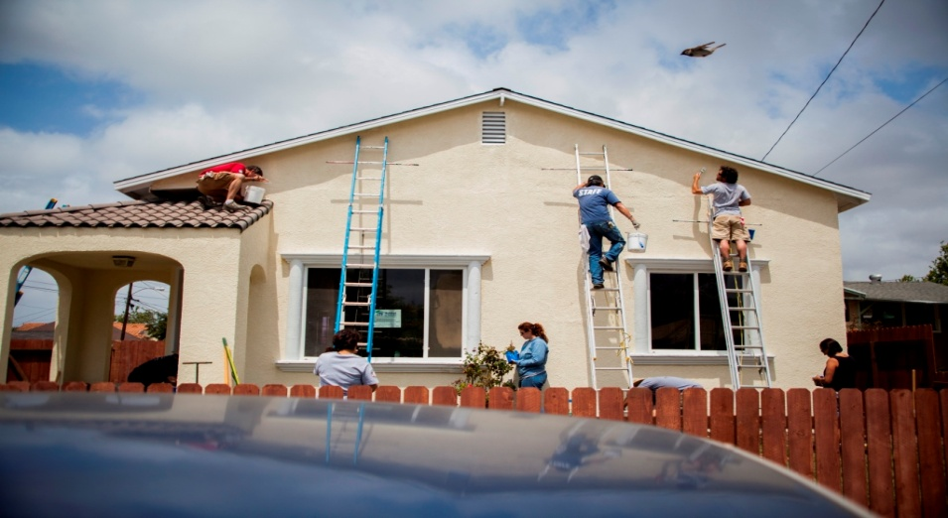
WHO WE ARE
Mission Statement
Seeking to put God’s love into action, Habitat for Humanity brings people together to build homes, communities and hope.
Our Vision
A world where everyone has a decent place to live.

Slide 3
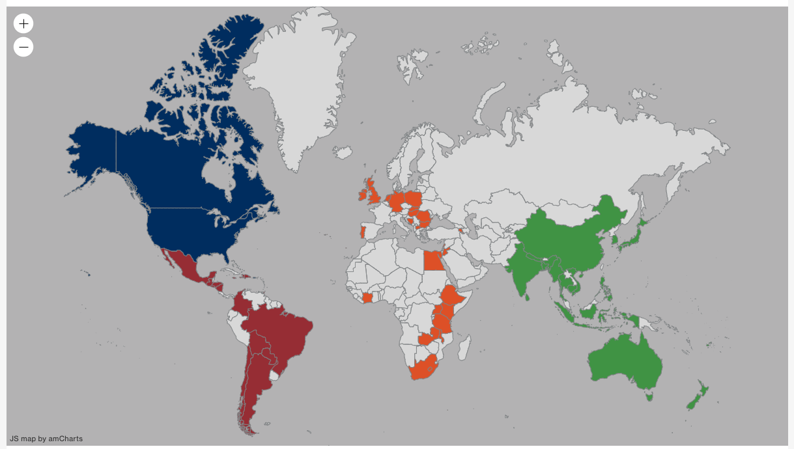
Habitat in 70 Countries Around the World!!

Slide 4
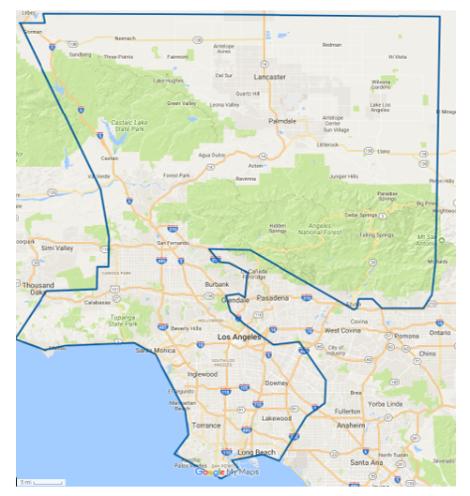
Habitat for Humanity of Greater Los Angeles Service Area
Notes:
ER

Slide 5
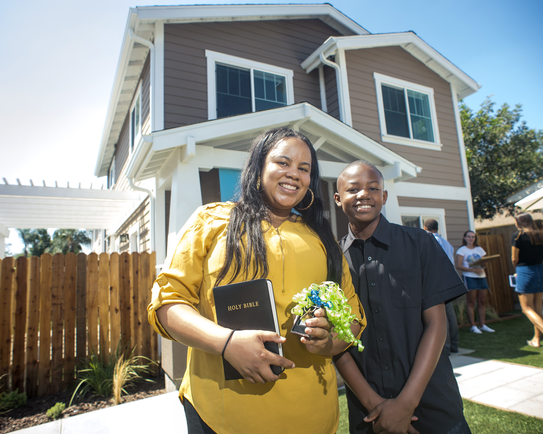
What is Habitat for Humanity’s Impact in the lives of people?
Over 35 million families have been served through Habitat for Humanity worldwide.
Habitat provides opportunities to change the trajectory of a family’s life by investing in the economic stability of each homebuyer now and in the future
Mortgage Affordability
No more than 35% of a family’s income will go to paying monthly mortgage payment.
Down Payment Assistance
Mortgage Lending
Bridging the homeownership gap for people of color.
Notes:
SE

Slide 6
Programs
New Home Construction
Home Repair
Neighborhood Revitalization
Covid-19 Relief Fund
Disaster Relief
ReStores
Pathways to Home Ownership

Slide 7
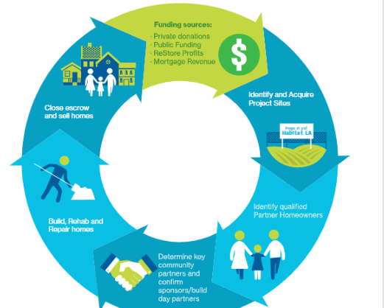
How has the Habitat for Humanity model proven to be successful over 46 years?
Notes:
SE

Slide 8
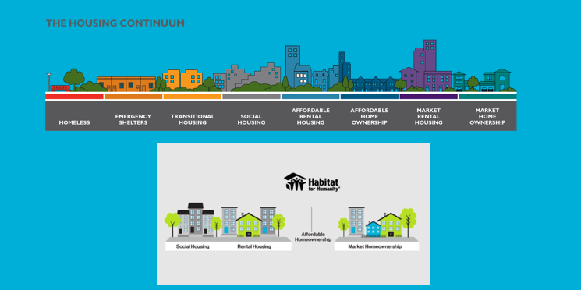
Where does Habitat for Humanity sit on the Housing Continuum Model?
Notes:
SE

Slide 9
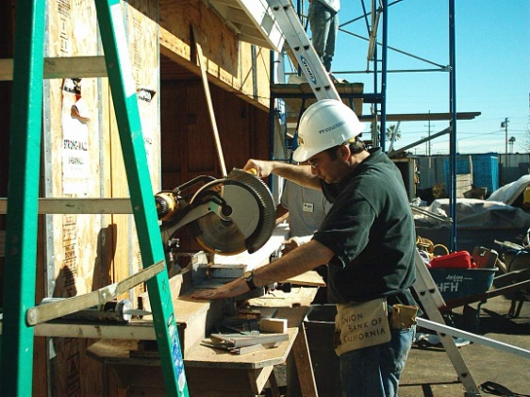
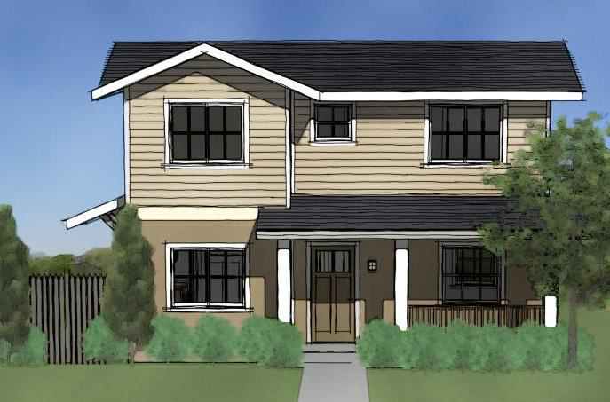
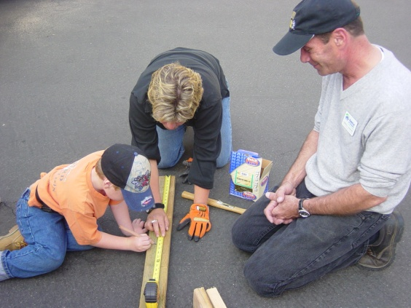
Volunteer
Fundraise
Lead
Find Families & Land
Advocate
Coalitions and Interfaith
Pray
WAYS TO SUPPORT!

Slide 10
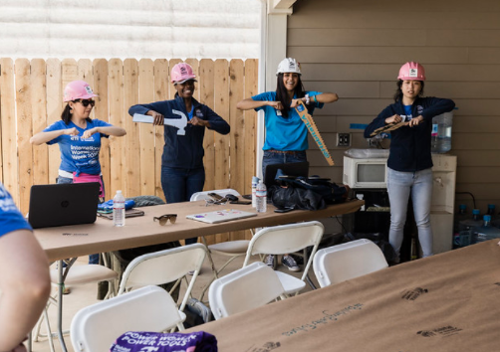
What’s Happening in 2022:
36 New Homes in Long Beach-
8 New Homes in South LA
Critical Home Repairs for Seniors, Veterans, and Low-Income Homeowners throughout greater LA.
Community Clean Ups in SFV
Notes:
ER

Slide 11
Questions?
Contact: Chris Untiet chrisu@habitatla.org
310-749-8575
Notes:
SE

